Slide 1
What’s New in SigmaXL V6.2
Presenter: John Noguera, P. Eng., MBB, Co-founder and CTO, SigmaXL, Inc.

Slide 2
AGENDA
New features in SigmaXL Version 6.2 include:
Compatible with Excel 2013, 32 and 64-bit versions and Mac Excel 2011
New Statistical Templates:
Minimum Sample Size for Robust t-Tests and ANOVA
1 Poisson Rate Test and Confidence Interval
2 Poisson Rates Test and Confidence Interval
One-Way Chi-Square Goodness-of-Fit Test
Updated Statistical Templates:
1 Sample t-Test and Confidence Interval for Mean
2 Sample t-Test and Confidence Interval (Compare 2 Means) with option for equal and unequal variance
1 Sample Chi-Square Test and CI for Standard Deviation
2 Sample F-Test and CI (Compare 2 Standard Deviations)
1 Proportion Test and Confidence Interval
2 Proportions Test and Confidence Interval

Slide 3
AGENDA
New features in SigmaXL Version 6.2 include:
The template Minimum Sample Size for Robust t-Tests and ANOVA answers the question, “How large does the sample size have to be for the central limit theorem to work?” This template is unique to SigmaXL and was developed using extensive Monte Carlo simulations. It provides a minimum sample size required for the 1 Sample t-Test, 2 Sample t-Test and One-Way ANOVA to be robust to non-normality. The user simply enters the sample Skewness and Kurtosis and obtains a minimum sample size required for the specified test.
Easy to interpret, color coded “Reject” or “Fail to Reject” the Null Hypothesis.

Slide 4
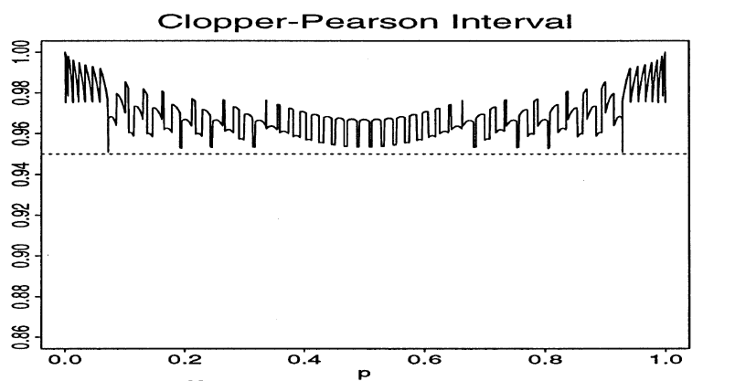
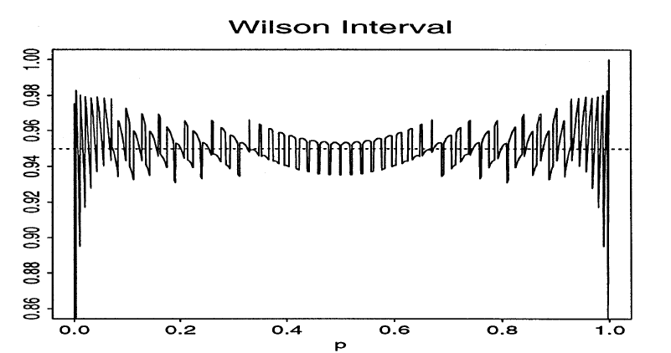
AGENDA
New features in SigmaXL Version 6.2 include:
Confidence intervals for 1 Proportion and 1 Poisson Rate templates include the traditional “exact” methods which are strictly conservative and guarantee the specified confidence level, but result in wide intervals. Alternatively, Wilson Score and Jeffreys intervals can be selected to provide narrow intervals that match the specified confidence interval on average. Normal approximation methods are also available for students to validate hand calculations.
Comparison of Coverage Probability for Exact (Clopper-Pearson) versus Wilson Score 1 Proportion Binomial, n = 50
Brown, L. D., Cai, T. T. and DasGupta, A. (2001), Interval estimation for a binomial proportion. Statistical Science, 16, 101-133

Slide 5
AGENDA
New features in SigmaXL Version 6.2 include:
Confidence intervals for 2 Proportions and 2 Poisson Rates include modern methods that result in narrow intervals that maintain the specified confidence level on average: Newcombe-Wilson and Jeffreys Hybrid.
Presentation: 50 Minutes; Q&A: 10 minutes

